Slide 1
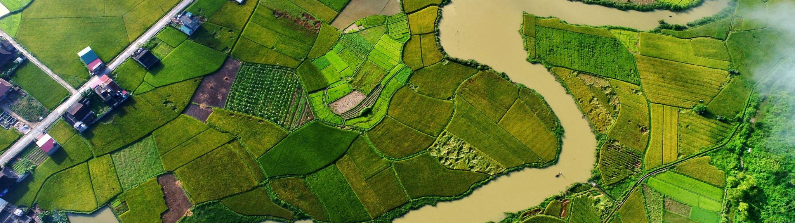
Rice Cultivation Monitoring in Vietnam
VALUE CASE PRESENTATION
Group 10:
Alina Adhikari
Mohanish Pradeep
Nathan Vaz
Shriyansh Urvishkumar

Slide 2
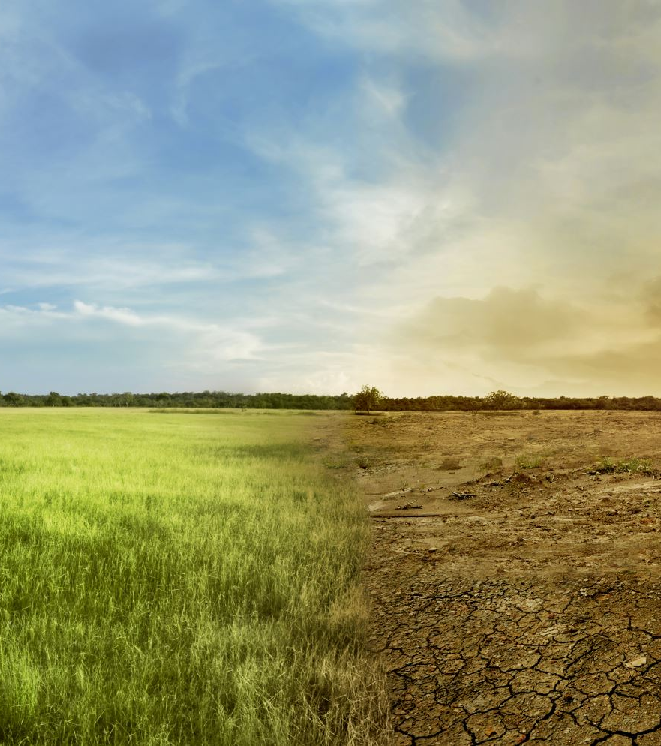
NEED FOR SATELLITE BASED CROP DETECTION
In recent years, we have been seeing several challenges in Agriculture:
Climate change, unsustainable land management, and increasing food demand are posing unprecedented challenges to global agriculture.
Soil health is crucial for sustainable agriculture and food security, but it's under threat due to erosion, nutrient depletion, and loss of organic matter.
Urgency for Technical Projects:
Technical projects utilizing advanced technologies are indispensable for combatting soil degradation .
By integrating satellite data, remote sensing, and data analytics, these projects enable real-time monitoring of soil conditions and crop dynamics.

Slide 3

Introduction to Challenge
EY data challenge phage 1; rice field identification [rice or non-rice field]
Datasets used
What kind of model was built?

Slide 4

ML MODEL DEVELOPMENT

Slide 5
Approach to building the model
1.Extracted the VV and VH values which were our predictor variables from the Sentinel -1 dataset.
2.Extracted the RVI (Radar Vegetation Index) from the mean VV and VH values.
3.Use of min-max scaling for scaling of independent variables
4.Training and Testing the model(Several models such as Random Forest, Decision Tree, XG Boost, SVM and KNN were utilized)
5.Hyperparameters tuning to find the best set of parameters
6.Training the model with the best parameters

Slide 6
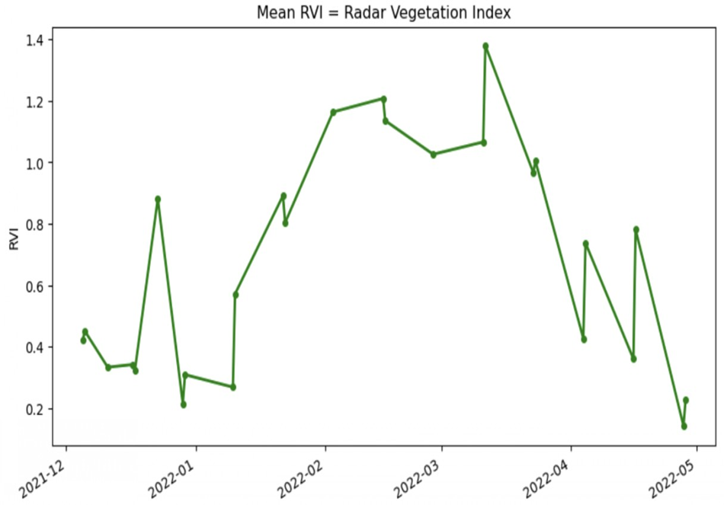
Key Methodologies used to improve results
Phase 1:Feature Engineering (VV-VH Ratios/DifferencesVV-VH ratio can help distinguish between different crop types or assess crop health and biomass
VV-VH difference can help discriminate between different crop types or detect changes in crop structure or moisture content
We experimented with multiple feature selection methodologies, including PCA and Ridge regression, in an effort to enhance the robustness of our model.
Phase 2: sentinel-1 significance of mean RVI values (Radar vegetation Index)

Slide 7
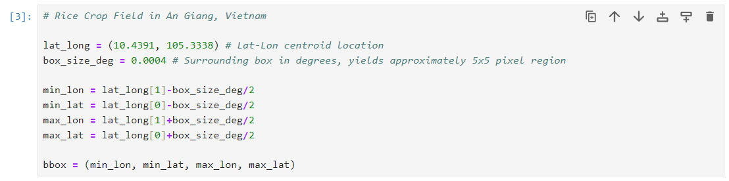
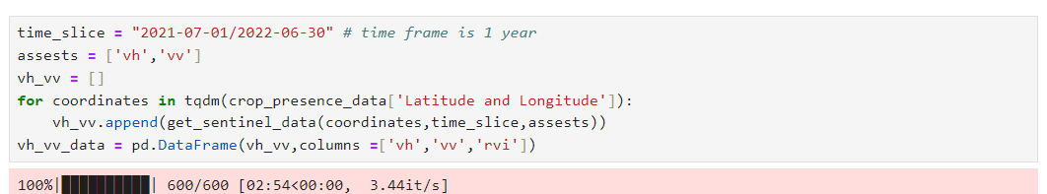
Phase 3: Bounding Box Approach
Phase 4: Time Period Consideration (1 year)

Slide 8
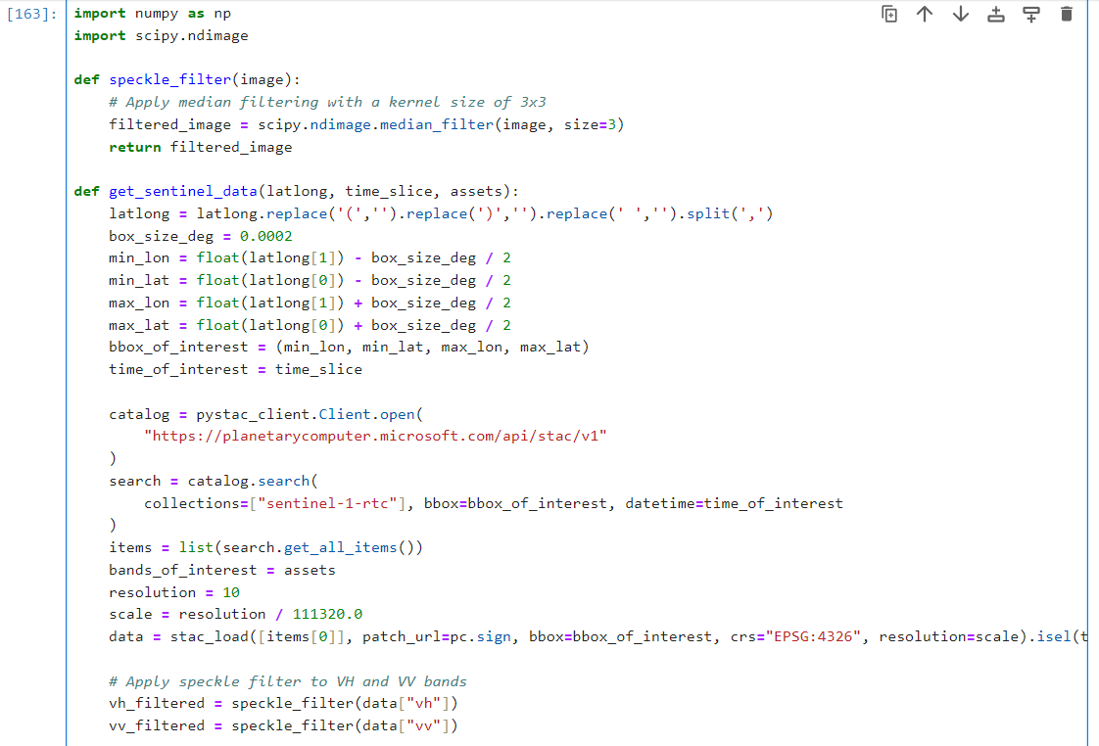
Phase 5: Implement speckle filters for noise reduction

Slide 9
Best Performing Model:
Random Forest model accuracy = 85 %
Performance on the scaled data = 83.33%
Decision: Development of a Stacking model comprising of the base models (Random forest, Gradient Boosting, Logistic Regression, KNN and XGBoost classifier)

Slide 10
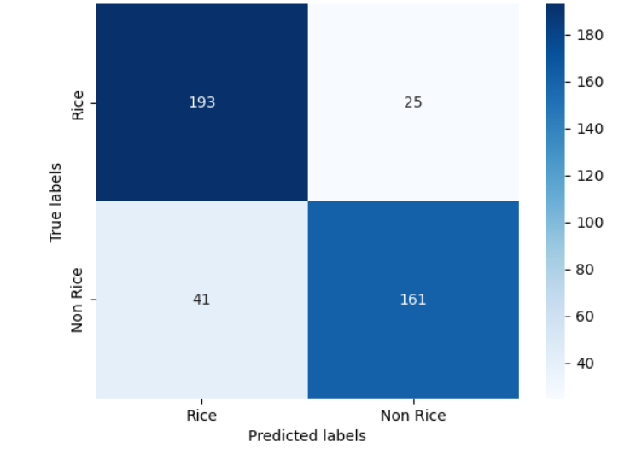
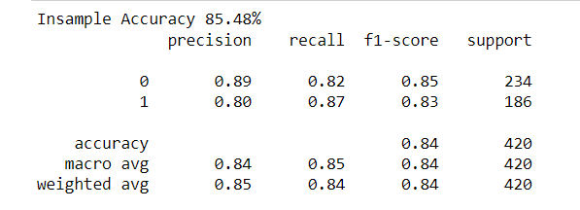
In sample accuracy: 85.48%

Slide 11
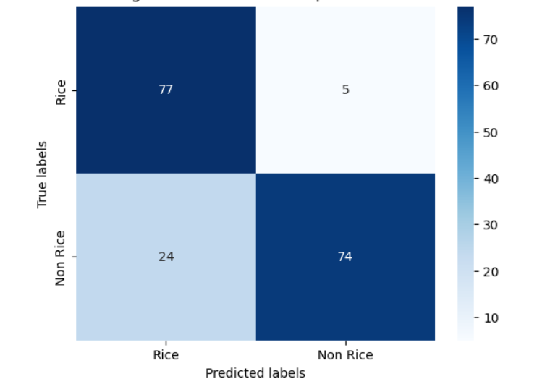
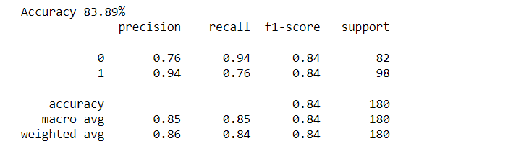
Outsample –Accuracy: 83.89%

Slide 12
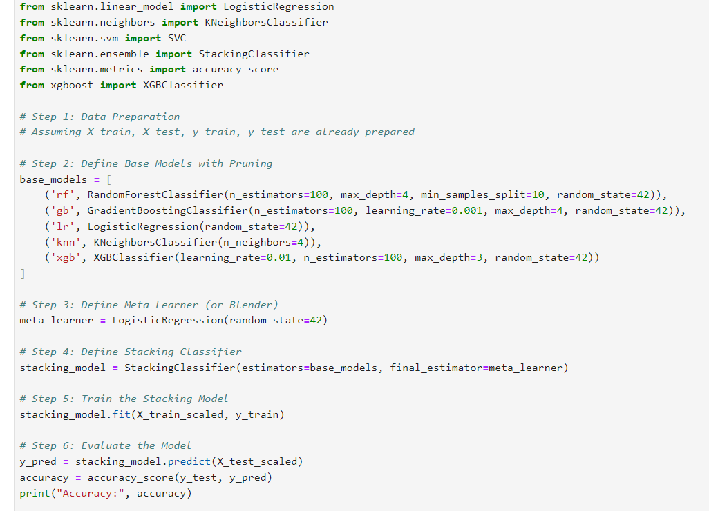
Stacked Model

Slide 13

Real time applications of the Data and Model

Slide 14
Applications of the data
Precision Agriculture for farmers
Land Use Planning
Policy Making and Governance
Enhancing Food security by optimizing rice cultivation
Data/ML Model
Farmers
Large Suppliers
Government and Non-Government Organizations
Agricultural Companies

Slide 15
Capitalizing the information
Value Proposition: Clearly articulate the value proposition of the rice field prediction data, emphasizing its role in optimizing agricultural practices
Demonstration and Education: Provide demonstrations and educational content to showcase the accuracy and reliability of the predictions and educate potential or target customer
Tailored Offerings: Tailored offerings involve customizing the products or services to meet the unique needs and preferences of different customer segments.

Slide 16

RETURN ON Investment
Cost Savings: If a farmer can precisely target irrigation to rice fields only, they can reduce water usage by 15%.
Reduced Input Costs: if a farmer can reduce fertilizer usage by 10% through precise application in rice fields
Enhanced Decision-Making: Improved crop management and risk reduction.
Environmental Benefits: Contribute to ecosystem conservation and water conservation. If farmers can avoid over-irrigating non-rice areas, they can conserve water for other uses.

Slide 17
IMPROVING THE RESULTS
What additional data or information could help to improve the results further?
High-resolution imagery
Ground truth data
Crop rotation patterns
Terrain and elevation data

Slide 18

overall Learnings
Understanding Satellite Data and Leveraging Satellite Data for ML Model Development
Stacking Models for Enhanced Predictions
Commercializing Data-Driven Insights
Beyond Business: Social Impact of ML in Agriculture
Fostering Effective Teamwork and Communication within Teammembers

Slide 19

QUESTIONS??

Slide 20
THANK YOU

